Slide 1
People and Events of Vietnam War

Slide 2
http://www.history.com/topics/vietnam-war/weapons-of-the-vietnam-war/videos/chicago-seven-conspiracy-trial
The Chicago Seven: The Chicago Seven (originally eight) were political radicals accused of conspiring to incite the riots that occurred at the 1968 Democratic National Convention in Chicago. During the five-month trial, the prosecution stressed the defendants’ provocative rhetoric and subversive intentions, while the defense attributed the violence to official overreaction. The case drew national attention for the artists and activists that testified as witnesses, as well as defendant Bobby Seale’s actions, which earned him four years in prison for contempt of court. In February 1970, five of the seven were found guilty, but an appeals court overturned the convictions in 1972.
There were originally eight defendants: David Dellinger, a pacifist and chairman of the National Mobilization against the War; Tom Hayden and Rennie Davis, leaders of the Students for a Democratic Society, Abbie Hoffman and Jerry Rubin, leaders of the Youth International Party John Froines and Lee Weiner, local Chicago organizers; and Bobby Seale, cofounder of the Black Panther party.
Except for the Panthers, who were uninvolved from the start, all the groups represented had planned massive demonstrations during convention week. But with the withdrawal of their principal target, President Lyndon B. Johnson, as a candidate for reelection and Chicago mayor Richard Daley’s increasingly threatening public statements about maintaining order, the appeal to “come to Chicago” became more muted. In the end, some ten thousand or so demonstrators gathered—enough to trigger a week of violent confrontations with the police, including one later termed by a federal commission a “police riot.”

Slide 3
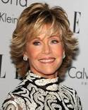
Hanoi Jane
Jane Fonda (born Jayne Seymour Fonda; December 21, 1937) is an American actress, writer, political activist, former fashion model and fitness guru. She is a two-time Academy Award winner and two time BAFTA Award winner. In 2014, she was the recipient of the American Film Institute AFI Life Achievement Award.

Slide 4
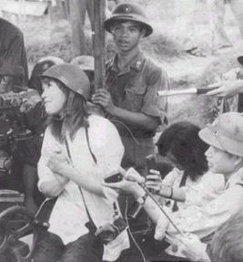
Fonda was an anti-war activist. Fonda visited Hanoi in July 1972 to witness firsthand the bombing damage to the dikes. After touring and photographing dike systems in North Vietnam, she said the United States had been intentionally targeting the dike system along the Red River. Columnist Joseph Kraft, who was also touring North Vietnam, said he believed the damage to the dikes was incidental and was being used as propaganda by Hanoi, and that, if the U.S. Air Force were "truly going after the dikes, it would do so in a methodical, not a harum-scarum way".
Fonda was photographed seated on a anti-aircraft gun; the controversial photo outraged a number of Americans, and earned her the nickname "Hanoi Jane".
She was married to Tom Hayden, one of the Chicago Seven.
Fonda has since apologized for her role in this picture.

Slide 5
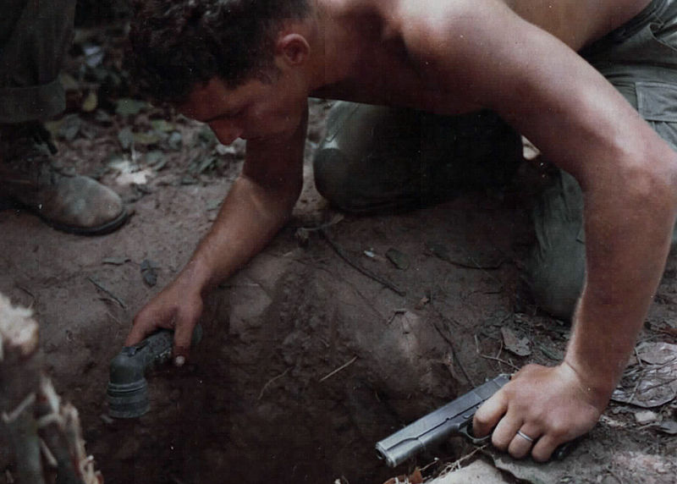
“Tunnel Rats”
The tunnel rats were American and Australian infantry soldiers whose task was to carry out underground search and destroy missions during the Vietnam War. The Viet Cong guerrillas had built a complex system of tunnels in which they hid themselves and their weapons when they were under attacks. They were extremely dangerous, with numerous booby traps and enemies lying in wait.
http://www.history.com/topics/vietnam-war/cu-chi-tunnels

Slide 6
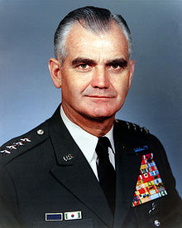
General Westmoreland
President Lyndon Johnson chose William Westmoreland, a distinguished veteran of World War II and the Korean War, to command the U.S. Military Assistance Command in Vietnam (MACV) in June 1964. Over the next four years, the general directed much of U.S. military strategy during the Vietnam War, spearheading the buildup of American troops in the region from 16,000 to more than 500,000. His strategy of attrition aimed to inflict heavy losses on North Vietnamese and Viet Cong forces using superior U.S. firepower, but resulted in a costly stalemate by late 1967. The enemy’s ambitious Tet Offensive in early 1968 cast serious doubt on Westmoreland’s claims of progress in the war effort, even as he called for some 200,000 more troops. Growing antiwar sentiment on the home front led President Johnson to halt bombing attacks on North Vietnam in March 1968, and in June he replaced Westmoreland.

Slide 7
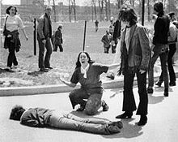
Kent State
The Kent State shootings (also known as the May 4 massacre or the Kent State massacre) occurred at Kent State University in Kent, Ohio, in the United States and involved the shooting of unarmed college students by the Ohio National Guard on Monday, May 4, 1970. The guardsmen fired 67 rounds over a period of 13 seconds, killing four students and wounding nine others, one of whom suffered permanent paralysis.
There was a significant national response to the shootings: hundreds of universities, colleges, and high schools closed throughout the United States due to a student strike of four million students, and the event further affected public opinion—at an already socially contentious time—over the role of the United States in the Vietnam War.

Slide 8
POWS and MIAS [Prisoners of War and Missing in Action]
During the course of the Vietnamese conflict, hundreds of Americans were incarcerated in Vietnamese prisons in North Vietnam, South Vietnam, Laos, Cambodia, and China. Many lived in barbaric conditions. Of these, 591 were released during Operation Homecoming, the prisoner repatriation program that was instituted at the war's end, in the spring of 1973. More than 2,000 Americans remained unaccounted for at that time.

Slide 9
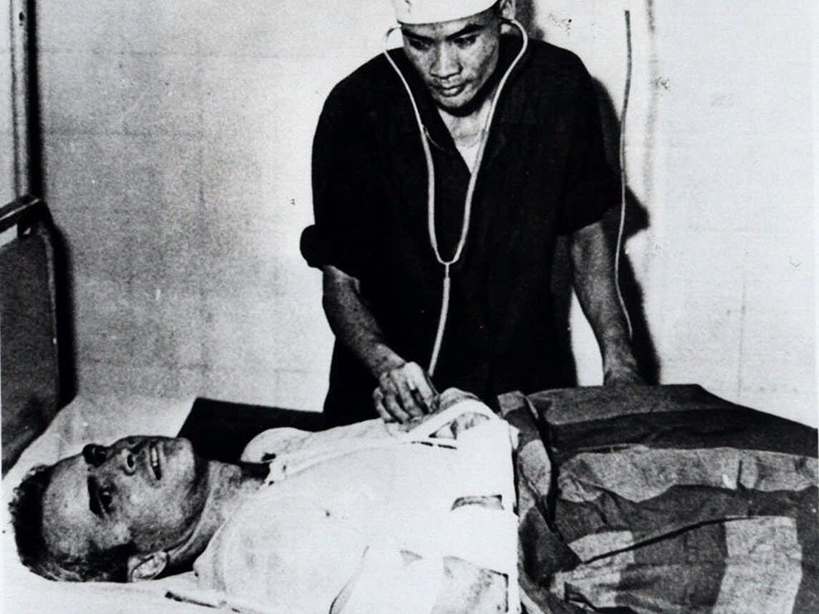
John McCain as POW

Slide 10
Horrifying "Hotels" From 1964 to 1973, the North Vietnamese had captured Americans, mostly pilots and crews of downed aircraft, and delivered them to prisons. Among the most notorious of these facilities was Hoa Lo, known by Americans as the Hanoi Hilton. Conditions at "the Hilton," along with the other large urban prisons and jungle camps throughout Vietnam, were horrifying.

Slide 11
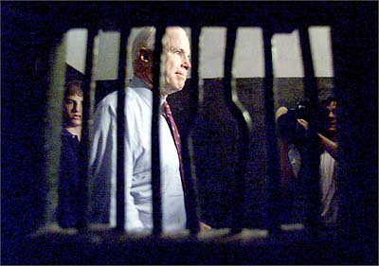
Senator John McCain revisiting the Hanoi Hilton years later.

Slide 12
Brutal Treatment Although the Geneva Convention of 1949 called for the decent and humane treatment of prisoners of war, these terms did not apply in Vietnam. The Vietnamese were accused of brutally torturing their captives -- beating them with fists, clubs, and rifle butts, flaying them with rubber whips, and stretching their joints with rope in an effort to uncover information about American military operations. The Americans were forced to record taped "confessions" to war crimes against the Vietnamese people and to write letters urging Americans at home to end the war. Poor food and medical care was standard. Prisoners were often isolated to prevent communication among each other, in addition to being denied communication with family members. American prisoners sometimes died in captivity, from wounds sustained in combat, or at the hands of their captors.

Slide 13
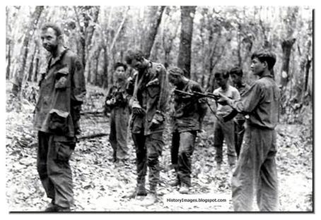

Slide 14
Even though both sides said that all POWs were returned after the war, many MIA/POW families believe their loved ones are still alive. They believe evidence shows American soldiers may still be alive in Vietnam. Thousands of live sightings of American soldiers in Vietnam have been reported since the war ended. Satellite photos have revealed images that P.O.W./M.I.A. advocates insist are coded distress signals burned or trampled into fields by American prisoners. In 1980, a reliable CIA contact reported seeing about 30 Americans working on a prison road crew in Laos. The U.S. Joint Special Operations Command prepared a rescue force, but press leaks and a badly bungled CIA reconnaissance mission stopped the rescue before it started.

Slide 15
A Glance at Vietnam & the War
Cut and paste this URL and watch the basics on Vietnam: http://www.history.com/shows/vietnam-in-hd/videos/deconstructing-history-vietnam
http://www.history.com/topics/vietnam-war/vietnam-war-history

